Slide 1




Mapping EU companies
from the CEE region, which are characterised by sustainable and
circular practices in construction
Green Crossing in Central Europe
- Greet CE
ZAG Ljubljana
23. 1. 2025
Alenka Bea Logar Pučnik

Slide 2
















About the Greet CE project
Type: Interregional Innovation Investments Instrument - I3 Project Grants- I3-2022-CAP2b
Duration: 24 months (20 November 2023 - 19 November 2025)
Project coordinator (LP): KSSENA
Programme: the Interregional Innovation Investment Facility (I3)
Managing Authority: EISMEA (European Innovation Council and SME Executive Agency)
More about the project: www.greetce.eu Co-funded by EUROPIAN INNOVATION COUNCIL AND SMES EXECUTIVE AGENCY (EISMEA)
Project consortium: 8 organisations from 6 countries with proven experience in business, social and technological innovation, EU projects and funding, and sustainable policy innovation, with associated partners - 21 organisations from 6 countries, including 5 universities (from 4 countries), 9 industry associations/clusters, 2 public authorities, 1 research institute and 4 SMEs. The project consortium brings together eight full project partners: Energy Agency for the Savinja, Šaleška and Koroška Region (KSSENA) - Slovenia, Chamber of Commerce and Industry of Slovenia (GZS) - Slovenia, Hrvoje Požar Energy Institute (EIHP) - Croatia, Bioeconomy Cluster (BEC) - Slovakia, Green Energy and Innovative Biomass Cluster (GEA) - Romania, Delfy consulting Kft (DELFY) - Hungary, Falcon Vision (FALCON VISION) - Hungary and Falcon Vision (FALCON VISION) - Hungary. All of these organisations offer free advice to interested parties in the framework of the GREET CE initiative.

Slide 3
Green Crossing in Central Europe
Fostering innovation for a sustainable future
The Greet CE project focuses on the Green Transition in Central Europe and is designed with the primary objective of increasing the innovation capacity of SMEs in less developed regions in Central Europe - Croatia, Hungary, Poland, Romania, Slovakia, Slovenia and the outermost regions of Portugal. ∙ Key objectives include facilitating the interaction of regional innovation ecosystems in EU value chains, improving opportunities for interactive training and education, fostering innovation potential, facilitating SME participation in I3 calls and increasing investment in innovation;
Increasing the capacity of regional innovation ecosystems, in particular SMEs in less developed Central European regions, to connect and interoperate in EU value chains and to participate in partnerships with other regions.
Unlock innovation potential to facilitate further SME participation in calls for proposals under Strand I3 1 and Strand 2a. The project will also help to create other opportunities for ERDF, Interreg and crowdfunding.
create the conditions for successful interregional cooperation and investment in common areas of smart specialisation, in particular in the field of the green transition, with a particular focus on the energy and bio-economy sectors.
The mission of the project is to promote the green transition, focusing on key areas :
◉ Bioeconomy, ◉ Energy ◉ Ecological construction

Slide 4
Creating sustainable development pathways
◉ Entrepreneurial and social innovation
◉ A multidisciplinary approach to smart specialisation
◉ Crowdfunding the Green Transition (crowdlending)
and clustering of energy efficiency projects
The project highlights the bioeconomy, energy and niche pilot projects such as eco-construction, digital (sustainable) energy, regenerative farming and renewable gases. By bringing together a consortium of experts from different fields, the project promotes the integration of EU value chains, interregional partnerships and crowdfunding opportunities, leveraging ERDF Interreg and other EU funding mechanisms. By working together, GREET CE aims to create pathways for sustainable development, strengthen regional innovation capacities and contribute to the EU's environmental and economic objectives.
Strengthening innovation through 4 pilot projects

Slide 5
Promoting sustainable innovation in construction
◉
Pilot project eco
Construction Pilot

Slide 6
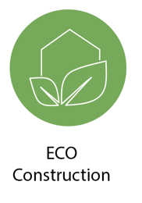
Eco CONSTRUCTION Pilot
Moving towards greener construction and smarter building materials
by fostering innovation, transformation and commercialisation of products and services
by strengthening cooperation at EU level
mobilising and optimising investment to transform EU value chains
supporting the replication of the results of I3 projects and their continued funding
at national and regional level, in particular in the context of programmes
ERDF and Interreg in EU Member States and regions
Industry value chain analysis
It covers the examination of the different stages of the production of a product/service, from procurement to final purchase by the end user.
Business case
It provides the rationale for launching a project, programme or portfolio within value chains, presented in a well-structured document, assessing the benefits, costs and risks of the alternatives and justifying the preferred solution.
Route plan
A strategic plan that defines a goal or desired outcome and includes the major steps or milestones needed to achieve it. It also serves as a communication tool. Smart Specialisation Strategies (S3) are one of the global methodologies for Science, Technology and Innovation (STI) roadmaps to achieve the Sustainable Development Goals. It uses bottom-up participatory processes.
Eco-building pilot project
focuses on the integration of sustainable building materials and techniques in construction. This initiative directly supports the ambitions of the European Green Deal for a climate-neutral Europe by 2050, focusing on reducing the carbon footprint of the construction sector and promoting bio-based materials, thus contributing significantly to the growth of the bio-economy sector.
We build capacity and connect SMEs from EU regions, support them in accessing EU funding and develop niche pilots

Slide 7

Pilot of ECO CONSTRUCTION
Strengthening innovation through Greet CE pilot projects
The standard pilot involves entities from at least 3 regions or countries. Pilot activities relevant to specific areas of interest will focus on areas (regions and/or countries) where the themes are particularly relevant for smart specialisation and where there are specific development potentials and niches. The pilot projects will strengthen the network of supporting policy makers and other relevant stakeholders and contribute to improving the business environment for competitive ecosystems in order to stimulate investment. The pilot action reports shall include an analysis of sectoral, business, cross-sectoral and inter-regional cooperation and policy issues, one outline of a potential I3 and other EU call proposal, including value chain, business case, issues, synergies, SWOT analysis and a total of at least 2 value chain analyses and 2 business cases with at least 6 companies involved.
Combinations
- according to 4 selected criteria
Market research
MSE identification
VALUE CHAINS
Market analysis database:
- Building materials and bio-based products
- Building materials and waste-based products
- Optimising construction (material) processes
- Other ecological construction
Consortium agreement:
- Circular building materials and products
- Climate-resilient buildings
- Circular industrial raw materials
- Energy upgrading of neighbouring buildings
- Other ecological construction
+
design and establishment
PARTNER PLATFORMS

Slide 8
VALUE LINKS ∙ Market analysis database:
∙Biobased building materials and products
COMPANY'S NAME | DESCRIPTION | COUNTRY
SAAX D.O.O. | specialising in architectural design, presenting EcoCocon's sustainable straw-based building system | SI
RUTENA D.O.O. | specialises in the development and production of innovative, sustainable packaging solutions using mycelium | SI
VU-CREATOR D.O.O. | specialises in the design and manufacture of high-quality solid wood children's furniture | HR
BONAVIA D.O.O. | specialised in the wood industry - furniture production | HR
ARUNDO BIOENERGY KFT | specialises in sustainable building materials, using Arundo Donax (giant reed), which grows on poor quality soil to produce environmentally friendly building products | HU
HEMP COOPERATIVE S.R.O. | specialises in innovative hemp-based solutions, developing hemp composting plates and mobile decorticators for the efficient post-harvest processing of hemp stalks | SK
B&G FAMILY INNOVATION SRL | specialises in natural mushroom cultivation, offering sustainable and quality products | RO
CASARBOR SRL | specialises in durable timber structures treated with advanced technologies for increased performance and longevity | RO
BAR-AT SYSTEM SRL | specialises in the construction of environmentally friendly homes with thermal insulation systems made of cellulose fibre, glass mineral wool and wood fibres | RO
MONDOIMPEX SRL | specialising in the production of garden furniture made of acacia wood | RO

Slide 9


VALUE LINKS ∙ Market analysis database:
∙ Building materials and waste-based products
COMPANY'S NAME | DESCRIPTION | COUNTRY
PRO LABOR D.O.O. | specialising in digitalisation, circular economy strategies and process optimisation for heavy industry sectors such as metallurgy and materials production | SI
KARSAI HOLDING ZRT | specialises in innovative, environmentally friendly solutions for road construction, offering recycled plastic grass grates that increase the load-bearing capacity of the soil | HU
TERRATICO J.S.A. | specialises in creating high-performance concrete alternatives using recycled plastic waste for sustainable construction | SK
DESIGN SOLUTIONS STUDIO SRL | specialises in the renovation and re-use of old bricks for construction purposes | RO
SADDAR | specialises in eco-anchors made from recycled PET composite materials that promote sustainable construction and circular economy practices | EN
INTERZERO plastics innovations d.o.o. | specialises in the analysis of recyclable materials and the development of recipes for the reuse of plastic waste id. | SI

Slide 10
VALUE LINKS ∙ Market analysis database:
Optimising construction (material) processes
COMPANY'S NAME | DESCRIPTION | COUNTRY
PREMIFAB D.O.O. | solvent recovery (waste management) | HR
SURVIOT MONITORING KFT | specialises in digital monitoring solutions for the construction industry, automating the collection of geotechnical and environmental data | HU
PANER KFT | specialises in non-invasive pipe maintenance and repair using robotic and No-Dig technologies | HU
INTERZERO plastics innovations d.o.o. | specialises in the analysis of recyclable materials and the formulation of recipes for the reuse of plastic waste, research and development innovator id. | SI

Slide 11
VALUE LINKS ∙ Market analysis database:
Other eco construction
COMPANY'S NAME | DESCRIPTION | COUNTRY
VEPLAS D.D. | specialises in the production of composite products and is an innovator for research and development | SI
DVIJE BOJE D.O.O. | specialising in eco-furniture, development of small buildings for tourists made of solid wood | HR
LIGNUM CIBALIAE D.O.O. | development of an innovative project aimed at the design and construction of an authentic Slavonian wooden house | HR
ISOCELL CONSTRUCT SRL | specialising in environmentally friendly cellulose insulation solutions | RO
BIOBUILDS SRL | specialises in creating environmentally friendly and innovative modular, prefabricated homes | RO
ECO LIVING PROJECT SRL | specialising in natural clay-based plaster solutions | RO
OLD WOOD SRL | specialises in the restoration and reuse of wood from old buildings for architectural and interior decoration purposes | RO
EXEL AIR TECH | specialises in large-scale air purification systems with electrostatic precipitators to capture fine dust and pollutants, support green building projects and improve urban air quality | EN
ENCOUSE | specialises in eco-friendly sanitation solutions for offices, providing resource-saving products such as waterless urinals and hand dryers for sustainable building practices | EN
YOUR WORLD VERTICAL GARDENS | specialises in the design and maintenance of vertical gardens for air purification for office spaces, improving urban green spaces and improving air quality in sustainable urban projects | EN
EXCLUSIVE | specialises in industrial process optimisation with an AI-powered platform that automates pricing for construction services, increasing efficiency in the interior design and eco-construction markets | EN

Slide 12
Proposed VALUE VERGES
  The modular timber and eco-construction value chain
  Sustainable insulation value chain
  The value chain of waste-based construction materials
  Traditional innovations in the eco-construction value chain
  Optimising construction (material) processes - digital solutions

Slide 13
VALUE LINKS ∙Proposal 1:
The modular timber and eco-construction value chain
COMPANY'S NAME | DESCRIPTION | COUNTRY
VU-CREATOR D.O.O. | specialises in the design and manufacture of high-quality solid wood children's furniture | HR
BONAVIA D.O.O. | specialised in the wood-processing industry - furniture production | HR
DVIJE BOJE D.O.O. | specialising in eco-furniture, development of small buildings for tourists made of solid wood | HR
CASARBOR SRL | specialises in durable timber structures treated with advanced technologies for increased performance and longevity | RO
MONDOIMPEX SRL | specialising in the production of garden furniture made of acacia wood | RO
BIOBUILDS SRL | specialises in creating environmentally friendly and innovative modular, prefabricated homes | RO
YOUR WORLD VERTICAL GARDENS | specialises in the design and maintenance of vertical gardens for air purification for office spaces, improving urban green spaces and improving air quality in sustainable urban projects | EN
 | +++ nzEB Clusters from the region, Passive House, Furniture Cluster

Slide 14
VALUE LINKS ∙Proposal 2:
Sustainable insulation value chain
COMPANY'S NAME | DESCRIPTION | COUNTRY
SAAX D.O.O. | specialising in architectural design, presenting EcoCocon's sustainable straw-based building system | SI
VEPLAS D.D. | specialises in the manufacture of composite products and is an innovator in research and development | SI
ARUNDO BIOENERGY KFT | specialises in sustainable building materials, using Arundo Donax (giant reed), which grows on poor quality soil to produce environmentally friendly building products | HU
HEMP COOPERATIVE S.R.O. | specialises in innovative hemp-based solutions, developing hemp composting plates and mobile decorticators for the efficient post-harvest processing of hemp stalks | SK
B&G FAMILY INNOVATION SRL | specialises in natural mushroom cultivation, offering sustainable and quality products | RO
BAR-AT SYSTEM SRL | specialises in the construction of environmentally friendly homes with thermal insulation systems made of cellulose fibre, glass mineral wool and wood fibres | RO
ECO LIVING PROJECT SRL | specialising in natural clay-based plaster solutions | RO
 | +++ nzEB Clusters from the region, Passive houses

Slide 15
VALUE LINKS ∙Proposal 3:
The value chain of waste-based construction materials
COMPANY'S NAME | DESCRIPTION | COUNTRY
PRO LABOR D.O.O. | specialised in digitalisation, circular economy strategies and process optimisation for heavy industry sectors such as metallurgy and materials production | SI
PREMIFAB D.O.O. | solvent recovery (waste management) | HR
KARSAI HOLDING ZRT | specialises in innovative, environmentally friendly solutions for road construction, offering recycled plastic grass grates that increase the load-bearing capacity of the soil | HU
TERRATICO J.S.A. | specialises in creating high-performance concrete alternatives using recycled plastic waste for sustainable construction | SK
DESIGN SOLUTIONS STUDIO SRL | specialises in the renovation and re-use of old bricks for construction purposes | RO
SADDAR | specialising in eco-anchors made from recycled PET composite materials that promote sustainable construction and circular economy practices | EN
INTERZERO plastics innovations d.o.o. | +++ Construction clusters from the region
 | specialises in the analysis of recyclable materials and the formulation of recipes for the reuse of plastic waste, research and development innovator id. | SI

Slide 16
VALUE LINKS ∙Proposal 4:
Traditional innovations in the eco-construction value chain
COMPANY'S NAME | DESCRIPTION | COUNTRY
LIGNUM CIBALIAE D.O.O. | development of an innovative project aimed at the design and construction of an authentic Slavonian wooden house | HR
OLD WOOD SRL | specialises in the restoration and reuse of wood from old buildings for architectural and interior decoration purposes | RO
OVSENIK joinery | developing innovative facade furniture finishes, | SI
 | +++ Building and timber clusters from the region, Architects, designers, Public authorities

Slide 17
VALUE LINKS ∙Proposal 5:
Optimising construction (material) processes - digital solutions
COMPANY'S NAME | DESCRIPTION | COUNTRY
SURVIOT MONITORING KFT | specialises in digital solutions for construction monitoring, automation of geotechnical and environmental data collection | HU
PANER KFT | specialises in non-invasive pipe maintenance and repair using robotic and No-Dig technologies | HU
EXEL AIR TECH | specialises in large-scale air purification systems with electrostatic precipitators to capture fine dust and pollutants, support green building projects and improve urban air quality | EN
ENCOUSE | specialises in eco-friendly sanitation solutions for offices, providing resource-saving products such as waterless urinals and hand dryers for sustainable building practices | EN

Slide 18

POTENTIAL EU SYNERGIES
DECORATOR is dedicated to fostering innovation in the construction sector with reference to sustainability and beauty.
13 partners - Slovenia (2), Germany (2), Austria (2), Croatia (2), Bosnia and Herzegovina (1), Hungary (2), Romania (1), Serbia (1)
https://interreg-danube.eu/projects/decorator/about-us

Slide 19

POTENTIAL EU SYNERGIES
WOODCIRCLES aims to revolutionise sustainable wood construction with circular solutions that reduce Europe's reliance on non-renewable resources, cut emissions, minimise waste, and promote long-term carbon storage.
20 partners - Denmark (3), United Kingdom (2), Finland (2), Romania (1), Spain (2), Italy (5), Sweden (1), Netherlands (2), Estonia (1), Austria (1)
https://urbasofia.eu/en/woodcircles/
https://woodcircles.eu/
Horizon Europe Funding Programme

Slide 20

POTENTIAL EU SYNERGIES
BIO4EEB aims to improve the use of generic bio-based materials and identify their use within a circular economy approach to create a much greener construction industry in the EU.
15 partners - Germany (1), Spain (3), France (2), Belgium (1), Hungary (1), Netherlands (1), Italy (3), Lithuania (1), Czech Republic (1), Austria (1), Colombia (1)
https://www.bio4eeb.eu/about/
https://www.bio4eeb.eu/consortium/

Slide 21
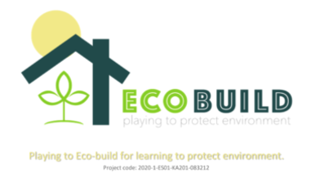
POTENTIAL EU SYNERGIES
ECOBUILD PROJECT provides students aged 12-16 with environmental knowledge through an educational serious game, an online resource centre and interactive activities that promote eco-awareness and sustainable building practices.
6 partners - Spain (3), Romania (1), Turkey (1), Italy (1)
https://ecobuildproject.com/about/

Slide 22
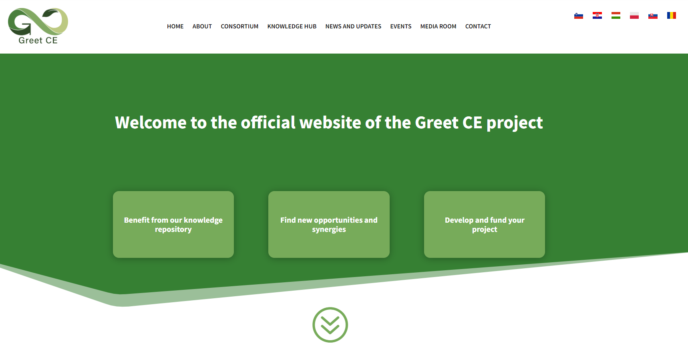
Establishing a PLATFORM for networking in the construction value chain
Potential green business partners website
Support website for processing applications for EU funding calls
Green Business Ideas Information Website
Help with applying for calls for tenders, including a letter of support:
Information on calls for tender, including for the ECO pilot -
networking with potential partners -
help with applying for calls for tenders, including a letter of support -

Slide 23
Next project steps
1. Action plan and timeline for the eco-construction pilot project
2. Definition of value chains
3. Value chain analysis - at least 2
4. Selection of SMEs from at least 3 regions
5. Dissemination and communication of results
6. Business case study - at least 6 SMEs involved
7. Policy analysis
Promoting sustainable innovation in construction! With GREET CE, citizens across Europe can now support green building projects that combine environmental innovation with financial returns.

Slide 24
Calls for tenders eligible for Eco-Build Pilot -2
https://greetce.eu/develop-and-fund-your-project/
HORIZON-CL5-2024-D4-02-04: Design for Adaptability, Re-use, and Deconstruction of Buildings
This call focuses on integrating innovative tools and processes for construction and renovation that enable buildings to be adaptable, reusable, and deconstructable. Proposals are expected to develop solutions for improving the lifespan and recyclability of building elements, including the use of CO2-storing materials and sustainable bio-based products. It encourages projects that validate these solutions in diverse climatic conditions and involve local and regional value chains.
Deadline: January 21, 2025
Funding: Up to EUR 4 million per project (total budget: EUR 8 million).
Details and Application: EU Funding Portal
HORIZON-CL5-2025-05-D4-01
Call: On-site innovative robotics and automated solutions for building renovation
Deadline: February 17, 2026
Details and Application: EU Funding Portal
HORIZON-CL5-2025-05-D4-03
Call: Innovative pathways for low-carbon and climate-resilient buildings
Deadline: February 17, 2026
Details and Application: Apply Here

Slide 25
Calls for tenders eligible for Eco-Build Pilot -2
HORIZON-CL5-2024-D4-02-03: BIM-based Processes and Digital Twins for Circular Energy Renovation
This call supports the use of digital tools such as Building Information Modeling (BIM) and digital twins to facilitate energy-efficient renovations and the integration of circular economy principles in building construction and renovation.
Deadline: April 18, 2024
Details and Application: EU Funding Portal
HORIZON-CL5-2024-D4-02-01: Industrialisation of Sustainable and Circular Deep Renovation Workflows
This call focuses on streamlining renovation processes for sustainable and circular deep renovations, particularly in the building sector. It encourages the industrialization of renovation workflows to improve efficiency and minimize energy consumption during building renovation.
Deadline: April 18, 2024
Details and Application: EU Funding Portal
HORIZON-CL5-2024-D4-01-01: Low-disruptive renovation processes using prefabricated solutions for energy-efficient buildings.
Deadline: April 18, 2024.
Details and Application.
LIFE Programme - Circular Economy and Quality of Life: Projects promoting eco-construction and low-carbon techniques.
Deadline: September 17, 2024.
Apply Here.
HORIZON-CL4-INDUSTRY-2025-01-TWIN-TRANSITION-31
Call: From heat-driven processes to mechanical processes in industrial sites
Deadline: September 23, 2025
Details and Application: EU Funding Portal

Slide 26
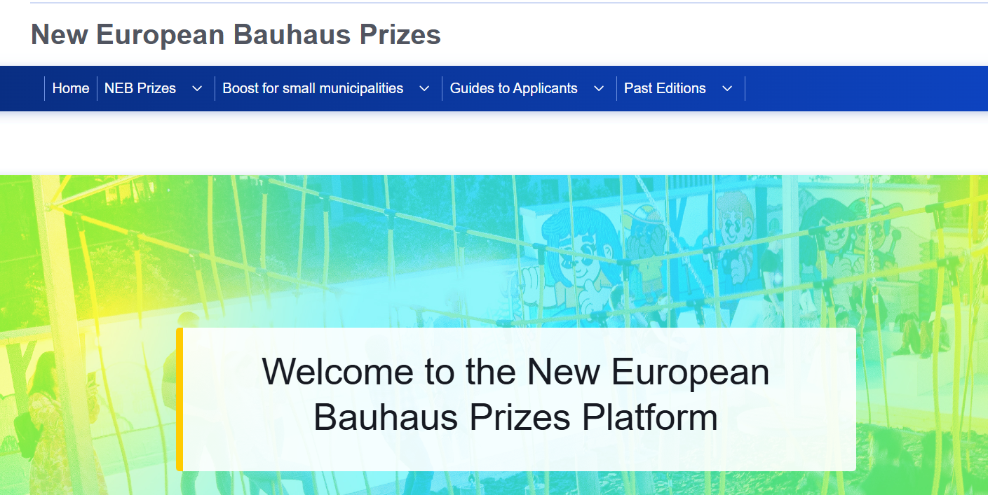
Get the Bauhaus Award!
https://prizes.new-european-bauhaus.europa.eu/

Slide 27
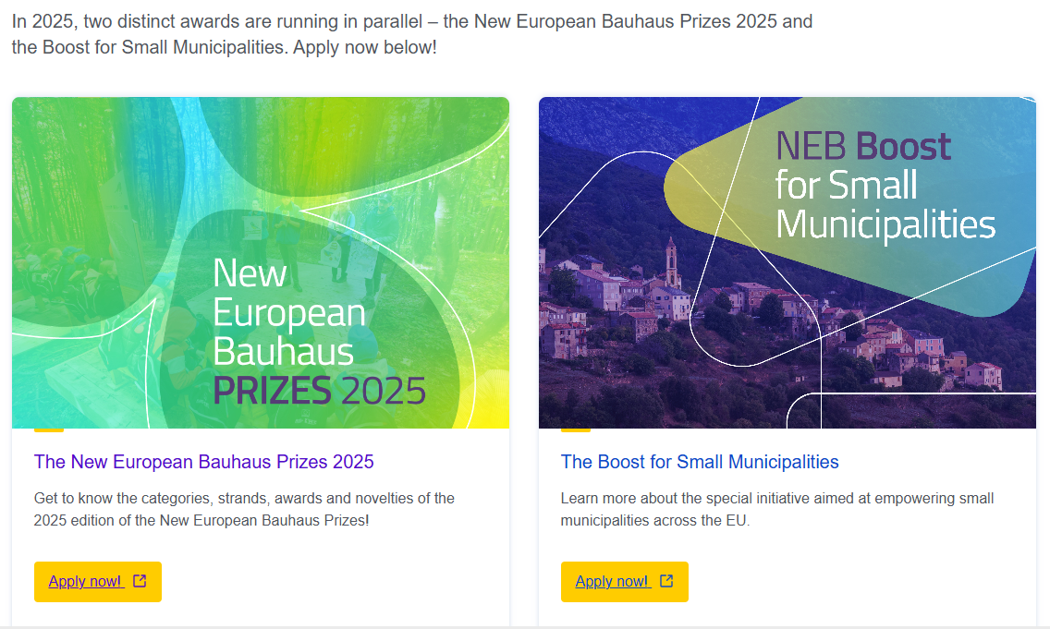
Get the Bauhaus Award!
https://prizes.new-european-bauhaus.europa.eu/

Slide 28
Thank you for your attention!
Contact us! for more information please visit www.greetCE.eu follow us on X
X.com/GREET CE
Linkedin https://www.linkedin.com/company/greet-ce-green-transition-in-central-europe/posts/?feedView=all
Contact:
Alenka Bea Logar Pučnik e: alenka.pucnik@gzs.si t: +386 31331467

